Slide 1
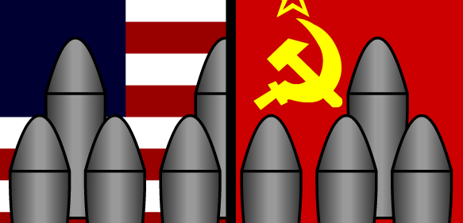
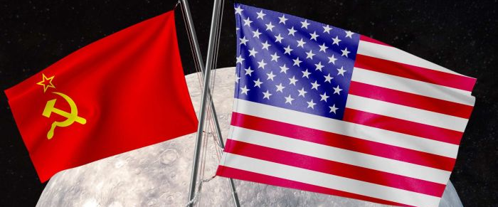
Cold War
Arms & Space Race

Slide 2

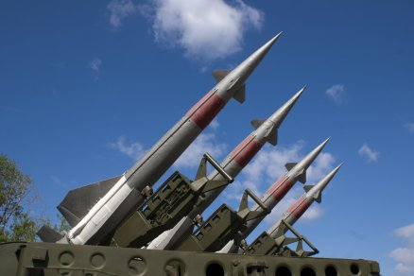
The Nuclear Arms Race
Refers to build up of nuclear weapons during the cold war by the U.S. and Soviet Union.
Began when the Soviet Union built their own H-Bomb in 1953.
Eventually both sides built Inter-continental Ballistic Misses (ICBMs) , could launch nuclear warheads around the world

Slide 3
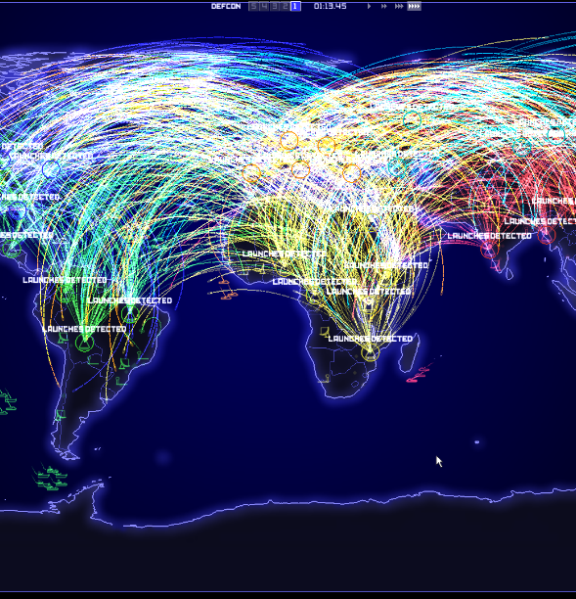
The Nuclear Arms Race
Huge amounts of money were spent on developing as many powerful Nuclear weapons as possible.
Mutual Assured Destruction theory (MAD), if war broke out between the U.S. and Soviet Union, both sides would be completely destroyed

Slide 4
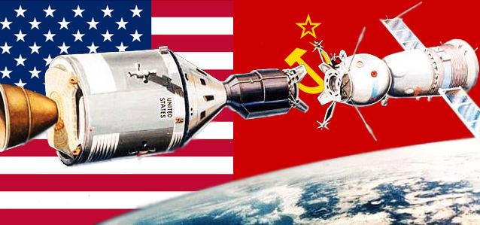
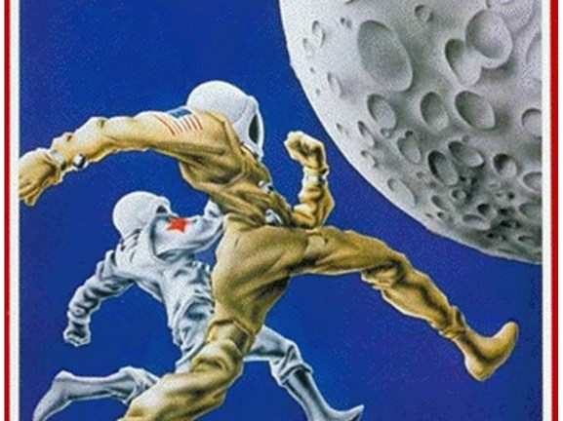
Space Race
Not only were the Soviet Union and U.S. competing with Nuclear Weapons. They were competing with technology in general.
The battle to prove who had the best technology is known as the Space Race.

Slide 5
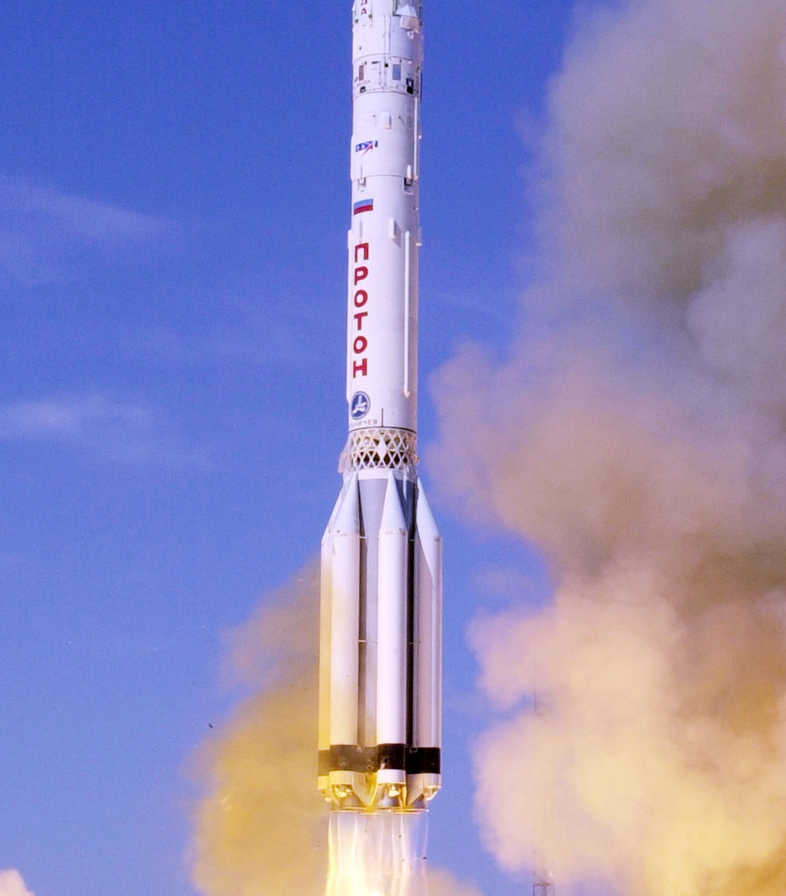
Space Race
The Space Race began when the Soviet Union launched Sputnik, the world’s first satellite.
Rockets that launch satellites are the same ones used to launch to missiles.
The U.S. was determined to prove they had technology to go into space.

Slide 6


Kennedy Moon Speech
We
Choose
To Go
To The
Moon

Slide 7
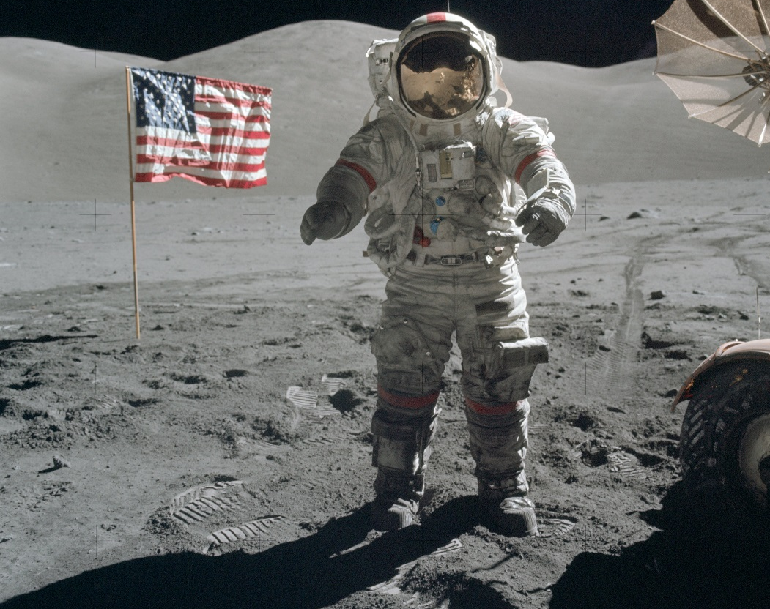
The Space Race
On July 20, 1969, Neil Armstrong was the first man to step foot on the moon. Ending The Space Race.

